Slide 1
Smart Contracts
Language Models
APIs
Web services
Test cases
…
Analytics
Extensionally defined relations
Data
Hardware, scale, cloud, multi-vendors, indexing, storage, replication, concurrency, recovery, distributed systems, …
Any computational artifact that that meets the invariants of a relation. Implementation could be using: Logic, Constraints, Search, Numerical Methods, Linear Programming, Symbolic Computation, Termination, Negation, Stratification, Neural Networks, Functional Programming, O-O Programming, Procedural P.
Intensionally defined relations
Rules / Code
Derived Relations
Relational Algebra, SQL, Datalog, (incl. Fixed Point Operators)
Query Optimisation

Slide 2
Logic, Constraints, Search, Numerical Methods, Linear Programming, Symbolic Computation, Termination, Negation, Stratification
Derived Relations
Relational Algebra, SQL, Datalog, (incl. Fixed Point Operators) Query Optimisation
Hardware, scale, cloud, multi-vendors, indexing, storage, replication, concurrency, recovery, distributed systems,
Extensionally defined relations
Data

Slide 3
Constraints, Relational Algebra, Linear Programming, SQL, Datalog, (incl. Fixed Point Operators) Query Optimisation, Logic, Search, Numerical Methods, Symbolic Computation, Termination, Negation, Stratification
Hardware, scale, cloud, multi-vendors, indexing, storage, replication, concurrency, recovery, distributed systems,
Extensionally defined relations
Data with Tuples containing constraints

Slide 4
σ_{P}(dom(A₁)× dom( A₂) × … × dom(A_{n}) )
σCI

Slide 5


Logic, Constraints, Search, SMT Solvers, Numerical Methods, Linear Programming, Symbolic Computation, Termination, Negation, Stratification, Type Theory, Multiple Semantics
⇒ ⇔ ¬ ∧ ∨ ∀ ∃ ! ≔ ⊢ ⊨
Hardware, scale, cloud, multi-vendors, indexing, storage, replication, transactions, concurrency, recovery, distributed systems, materialisation, backup, …
Intensionally Defined Relations (Rules)
Extensionally Defined Relations (Data)
relations
Relational Queries with Fixed-Point Operators
SQL, Datalog, LINQ, PRQL, Morel, …
σ π ρ υ – X ⋈
Derived Relations (Rules applied to Data)

Slide 6
Logic, Search, SMT Solvers, Numerical Methods, Constraint Programming, Symbolic Computation, Type Theory
⇒ ⇔ ¬ ∧ ∨ ∀ ∃ ! ≔ ⊢ ⊨
Hardware, scale, cloud, multi-vendors, indexing, storage, replication, transactions, concurrency, recovery, distributed systems, materialisation, backup, …
Sigma Complete Relations (Computations and Business Logic)
Data Relations (Data)
relations
Relational Expressions with Fixed-Point Operators
Relational Algebra, SQL, Datalog, LINQ, PRQL, Morel, Malloy, …
σ π ρ υ – X ⋈
Derived Relations (Data Transformation and Computation)

Slide 7
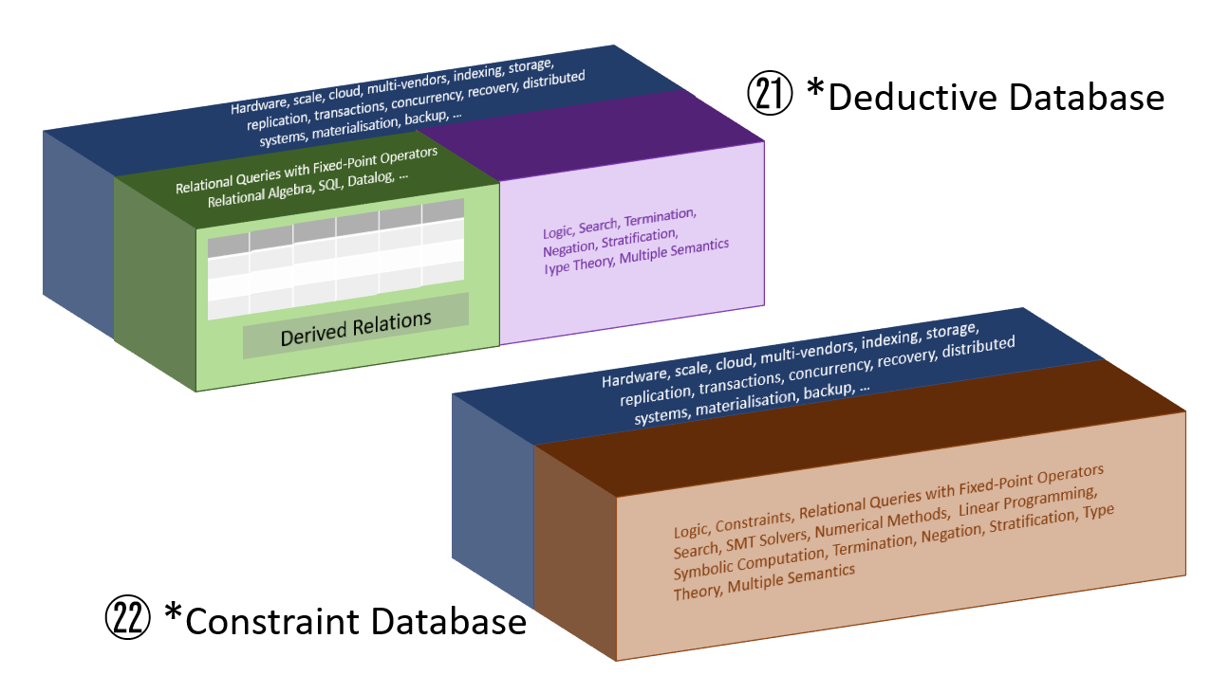
Logic: Termination, Negation, Stratification, Semantics, Constraint Logic Programming³: Search, Solvers, Numerical Methods, Linear Prog., Symbolic Comp., Type Theory,
³ Candidates include:
MiniZinc, {log}
②
㉕ Logic & Databases
㉛ Deductive …
㉜ Constraint …
㉘
⇒ ⇔ ¬ ∧ ∨ ∀ ∃ ! ≔ ⊢ ⊨
㉑ Ground facts
Hardware, scale, cloud, multi-vendors, indexing, storage, replication, transactions, concurrency, recovery, distributed systems, materialisation, backup, …
①
¹ non-extensionally-defined
and non-derived
⑮ Effectiveness
⑲ Superkeys and Func. Dependencies
⑱ Encapsulation of logic.
Intensionally Defined Relations¹ (Rules)
⑪
㉗ Normalisation & de-normalisation
⑤
LATERAL join ⋈
⑧ Variety of Logics
⑳
㉔
⑩
Join ⋈
pushdown
Aggregation
pushdown
Extensionally Defined Relations (Data)
Predicate
pushdown
④
⑭ Relational Model
⑦ Datasets
㉒ Separation of Concerns
㉓ Relations defined in 3 ways
² without
extensions
(Design principle)
Relational Queries with Fixed-Point Operators
Relational Algebra, SQL, Datalog², SDQL, LINQ, PRQL, Morel, …
⓪ ① ② ③ ④ ⑤ ⑥ ⑦ ⑧ ⑨ ⑩ ⑪ ⑫ ⑬ ⑭ ⑮ ⑯ ⑰ ⑱ ⑲ ⑳
⓪ The programmer’s experience
⑫ Working Software
⑬ Rules as Code
⑰ Case Studies
③
㉕ Summarising (or containing) constraints
σ π ρ υ – X ⋈ LATERAL
⑯ “Intensional Database IDB”
⓪ ① ② ③ ④ ⑤ ⑥ ⑦ ⑧ ⑨ ⑩ ⑪ ⑫ ⑬ ⑭ ⑮ ⑯ ⑰ ⑱ ⑲ ⑳ ㉑ ㉒ ㉓ ㉔ ㉕ ㉖ ㉗ ㉘ ㉙ ㉚ ㉛ ㉜ ㉝ ㉞ ㉟ ㊱ ㊲ ㊳ ㊴ ㊵ ㊶ ㊷ ㊸ ㊹ ㊺ ㊻ ㊼ ㊽ ㊾ ㊿
A relation is a σ_{P}(dom(A₁)× dom( A₂) × … × dom(A_{n}) ) for some predicate p and attributes A₁, A₂, …, A_{n.}
An extensionally-defined relation captures the relation as a list of tuples.
An intensionally-defined relation directly computes σ_{P}(dom(A₁)× dom( A₂) × … × dom(A_{n}) ) in the context of a relational query.
A derived relation is the result of a relational query over one, or more, relations of any type.
Derived Relations (Rules applied to Data)
⑥
⑨ Relational Algebra
David Pratten 2023

Slide 8
Hardware, scale, cloud, multi-vendors, indexing, storage, replication, transactions, concurrency, recovery, distributed systems, materialisation, backup, …
㉑ *Deductive Database
Relational Queries with Fixed-Point Operators
Relational Algebra, SQL, Datalog, …
⇒ ⇔ ¬ ∧ ∨ ∀ ∃ ! ≔ ⊢ ⊨
Logic, Search, Termination, Negation, Stratification, Type Theory, Multiple Semantics
Extensionally Defined Relations (Data)
Derived Relations
Hardware, scale, cloud, multi-vendors, indexing, storage, replication, transactions, concurrency, recovery, distributed systems, materialisation, backup, …
⓪ ① ② ③ ④ ⑤ ⑥ ⑦ ⑧ ⑨ ⑩ ⑪ ⑫ ⑬ ⑭ ⑮ ⑯ ⑰ ⑱ ⑲ ⑳ ㉑ ㉒ ㉓ ㉔ ㉕ ㉖ ㉗ ㉘ ㉙ ㉚ ㉛ ㉜ ㉝ ㉞ ㉟ ㊱ ㊲ ㊳ ㊴ ㊵ ㊶ ㊷ ㊸ ㊹ ㊺ ㊻ ㊼ ㊽ ㊾ ㊿
Logic, Constraints, Relational Queries with Fixed-Point Operators
Search, SMT Solvers, Numerical Methods, Linear Programming, Symbolic Computation, Termination, Negation, Stratification, Type Theory, Multiple Semantics
Extensionally Defined Relations (Data)
㉒ *Constraint Database

